Slide 1
UNIT 3
GENOME AND DATA SEQUENCE ANALYSIS

Slide 2

DNA sequencing – Sanger sequencing

Slide 3
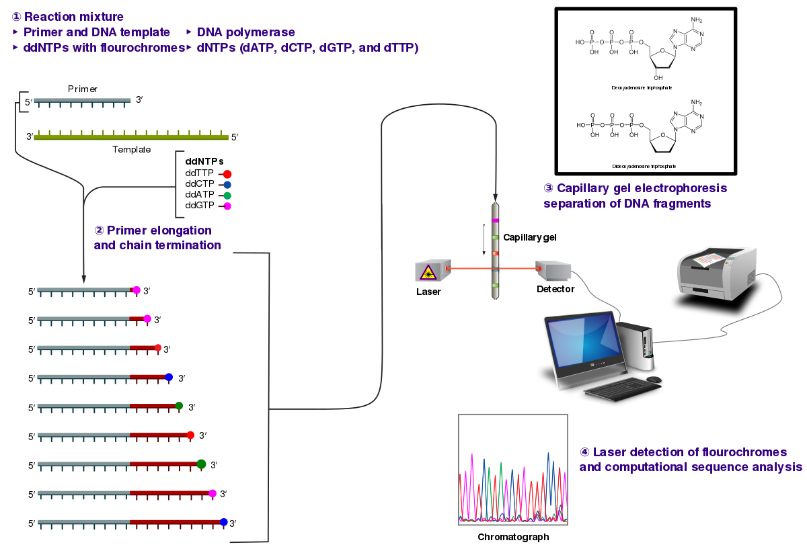
Sanger sequencing

Slide 4
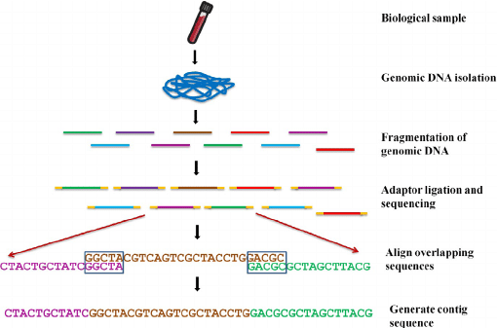
Next generation sequencing

Slide 5
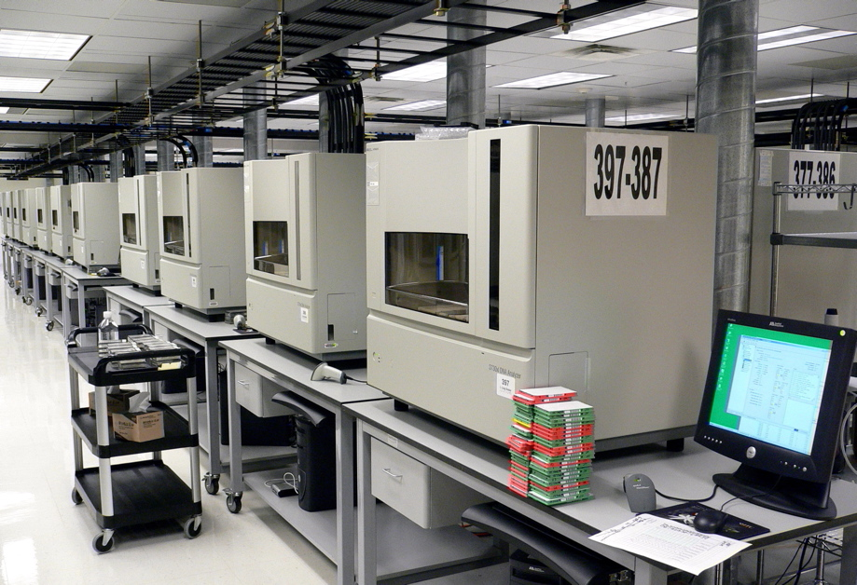
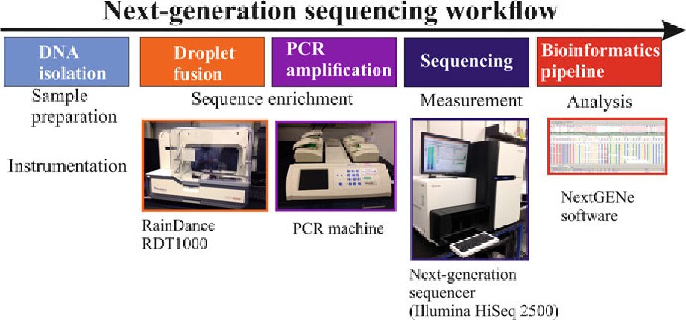
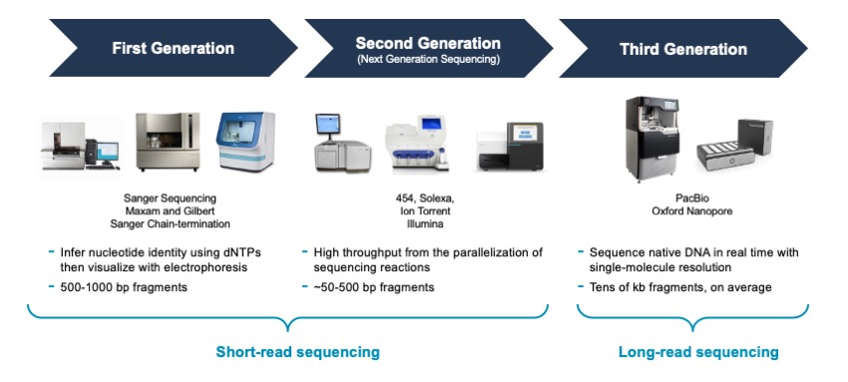
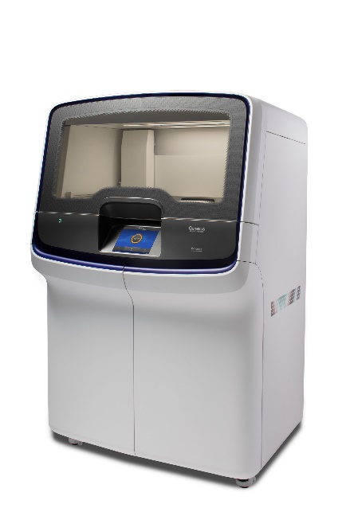

Slide 6
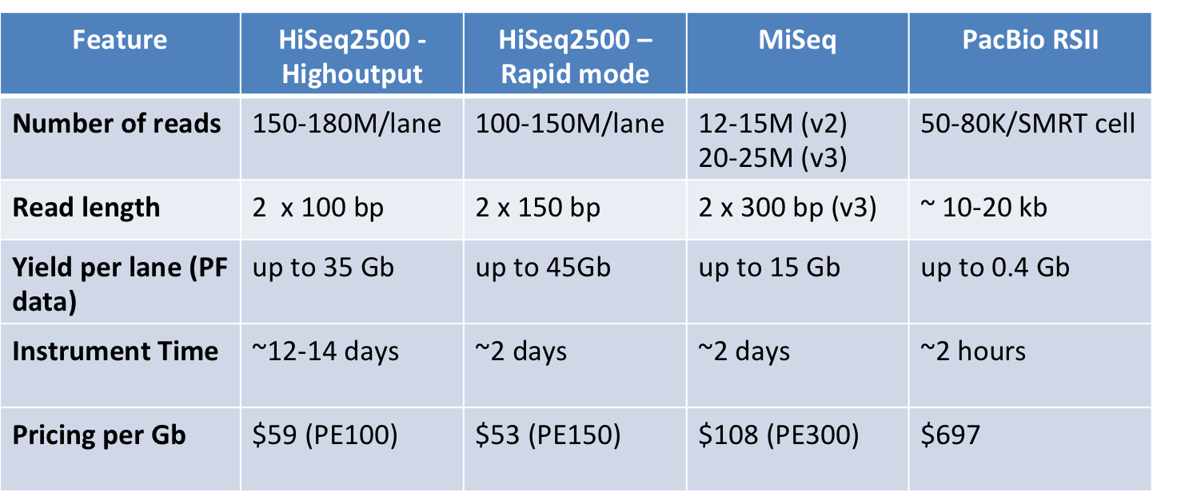
Next generation sequencing

Slide 7
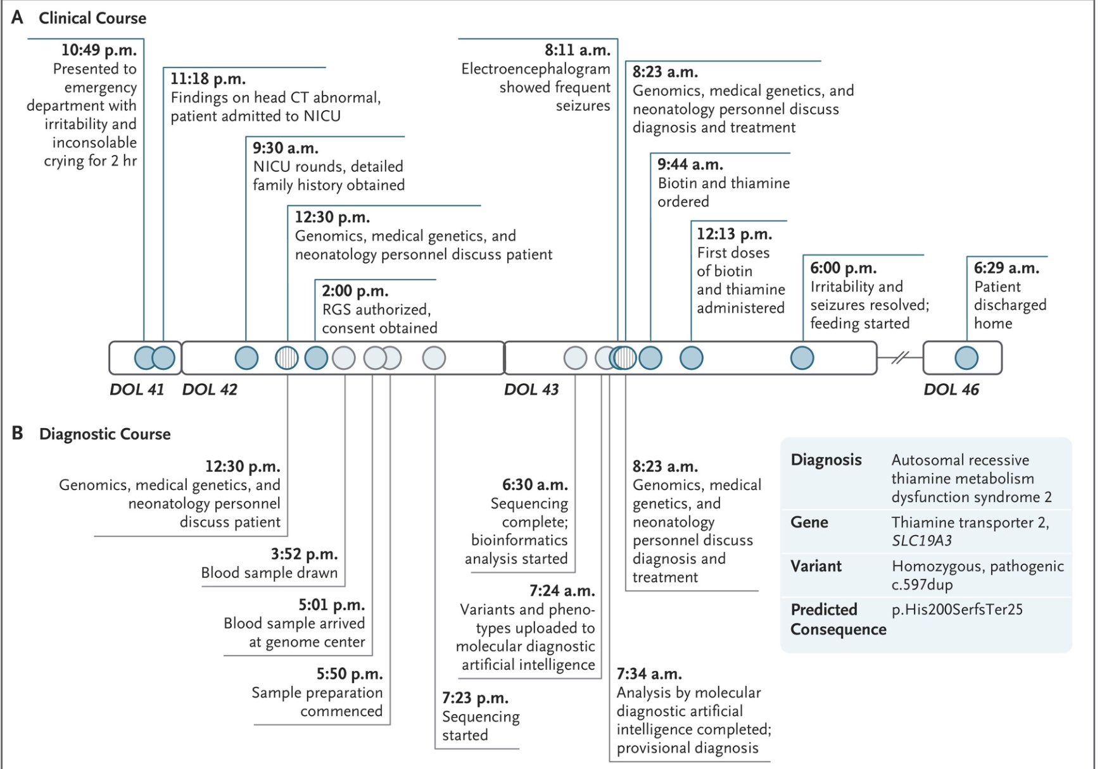
Power of Genomics and Bioinformatics

Slide 8
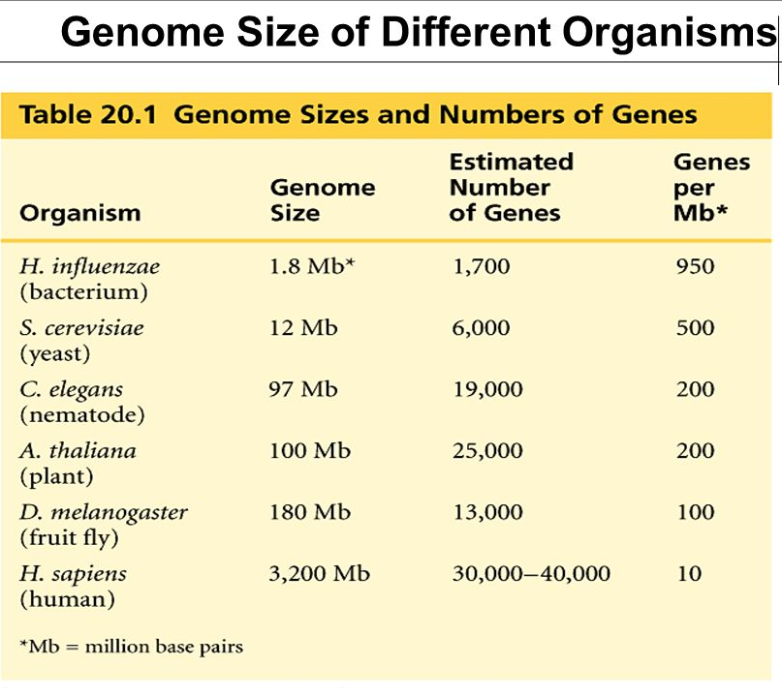
Purpose of sequencing-gene and genome
Benefits
Improvements in medicine
Studying the mutations
Biofuels
Forensics
Agriculture and livestock (GMOs)
Evolution and migration
Early risk assessment- Breast cancer
Consanguinity
Avoiding implantation of defective embryos in IVFs

Slide 9
Human genome
3 billion base bp (3x10^9 bp)
Fills 15000 phone book pages (ATGC)
30,000 genes
<2% protein coding
50% unknown function
99.9% similar
0.1% Variable number tandem repeats (VNTR and SNPs)
Sequencing completed in 2000

Slide 10
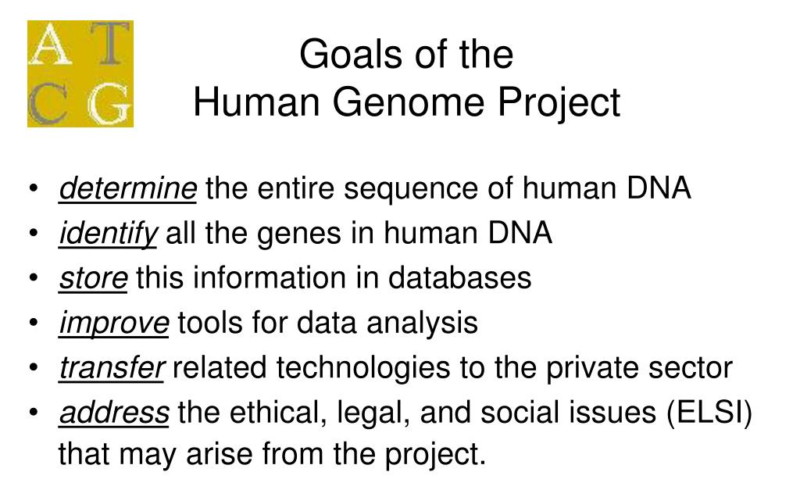
Human genome project

Slide 11
Timeline of HGP
1970-Fredrick Sanger- Sanger sequencing
1985-Robert Sinsheimer at UCSC proposed the idea of sequencing the human genome
1986-US Department of energy and National institute of health came forward to fund the human genome project
1989- UK medical research council joined the project
1990-3 billion dollar project was launched
13 year long project
Participating countries- US, UK, Japan, Germany, France, Canada, China
2003- Completed

Slide 12
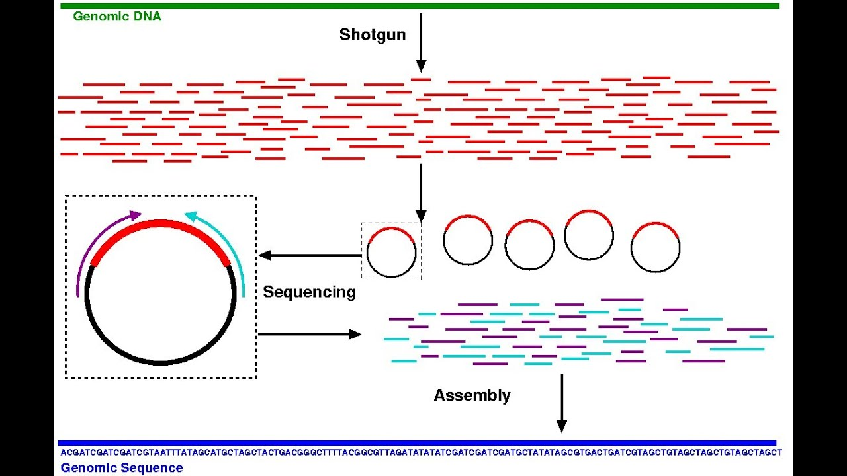
Process of Human Genome Project
Digestion of Human DNA
Cloning of fragments in Bacteria
Sanger sequencing of fragments
Overlap Assembly using software

Slide 13
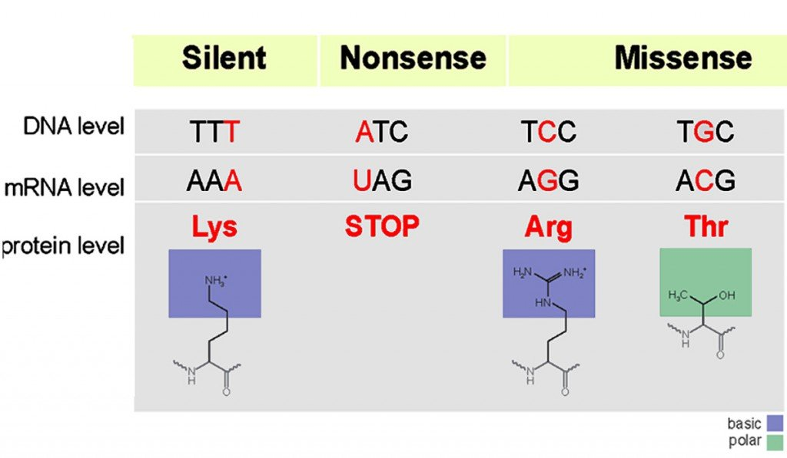
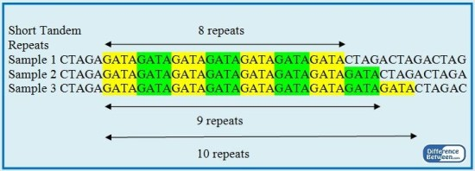
Population and variations
Though humans are 99.9% similar genetically, the variation in their phenotypes and genotypes are due to the presence of mutations (insertions, deletions, single nucleotide polymorphisms) and variable number of tandem repeats

Slide 14
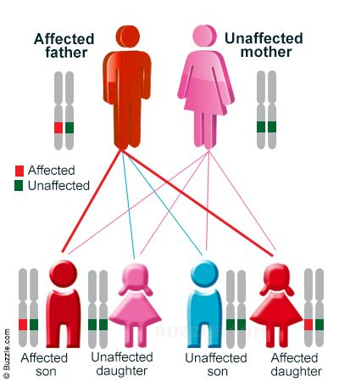
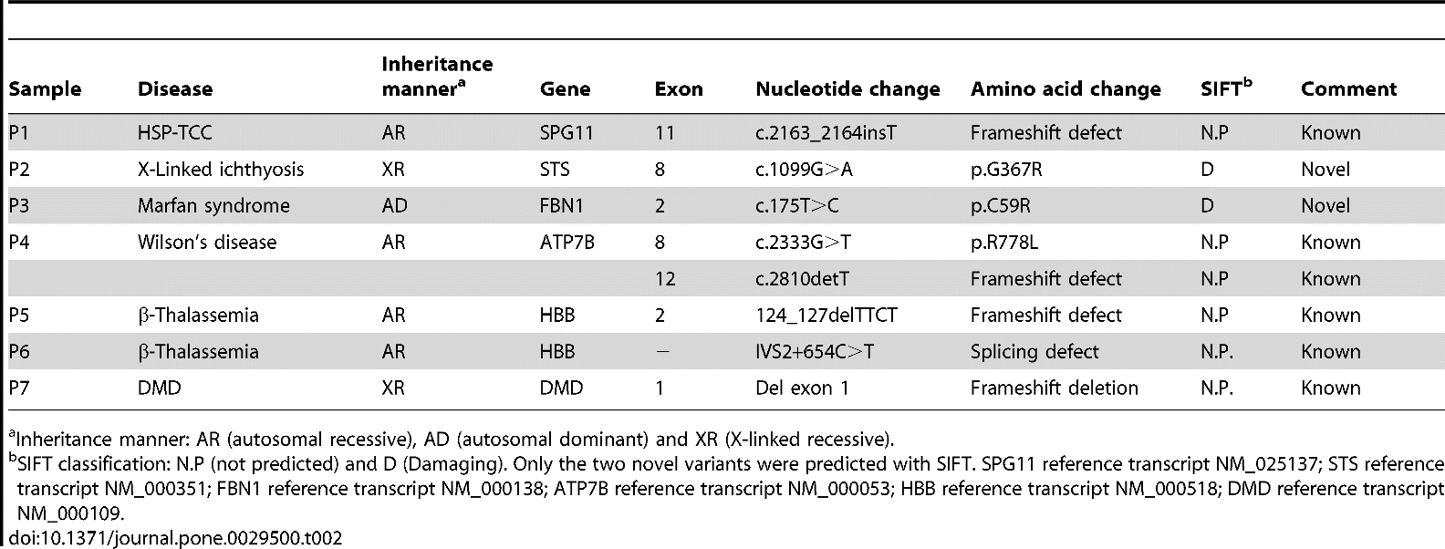
Genetic diseases- Inheritable

Slide 15
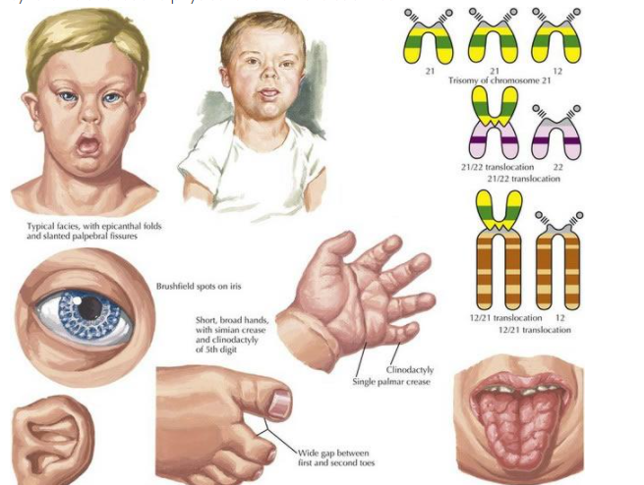
Down’s Syndrome

Slide 16
Choose the best answer
1. The human genome is: a) All of our genes b) All of our DNA c) All of the DNA and RNA in our cells d) Responsible for all our physical characteristics
2. How many chromosomes do humans have? a) 46 b) 48 c) 54 d) 56
3. DNA and RNA are each made up of four chemical bases joined to a sugar and phosphate, called nucleotides, that match up with each other. In DNA, the adenine base forms special bonds to make a base pair with: a) Guanine b) Cytosine c) Thymine d) Uracil
4. Genes are made up of: a) DNA b) RNA c) Proteins d) Enzymes
5. Scientists now think humans have how many protein-encoding genes: a) 20 - 25,000 b) 30 - 40,000 c) 65 - 75,000 d) more than 100,000

Slide 17
6. When a gene is 'expressed' it is: a) Transported around the body to make proteins b) Used as a blueprint to assemble the protein it codes for c) Passed on from parents to children d) Replicated within the cell
7. Genes for which of the following are coded on the Y chromosome: a) Hemophilia b) Testosterone c) Male pattern baldness d) Testis development
8. Gene mutations happen: a) Twice as often in egg cells than sperm cells b) Twice as often in sperm cells than egg cells c) At the same rate in both types of cells d) The sex germ cells are not related to mutation
9. Which of the following is controlled by a single gene: a) Height b) Mathematical ability c) Breast cancer d) Cystic fibrosis
10. Trisomy 21 is better known as: a) Edwards syndrome b) Patua syndrome c) Down syndrome d) Warkany syndrome 2

Slide 18
Thank you

